Slide 1
Image Classification
Paramita Chakraborty

Slide 2
Problem Statement
Deep dive into various ways of image classification
OpenCV, Traditional ML and CNN methods have been analyzed
We would be classifying cats Vs dogs

Slide 3
Data
CIFAR data set having 202 images each of cats and dogs (total of 404 images) have been considered

Slide 4
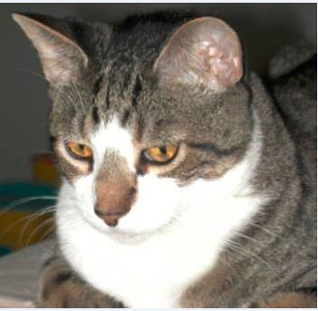
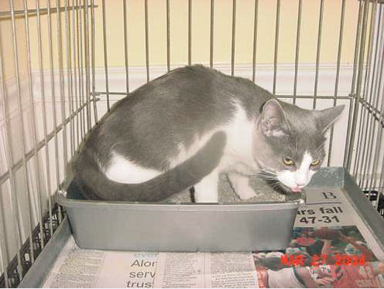
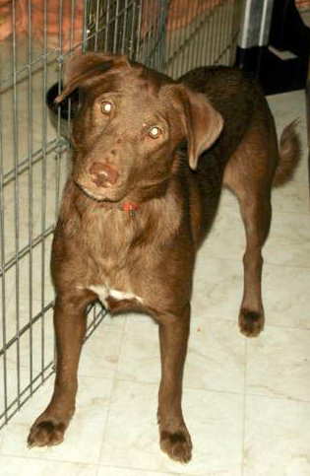
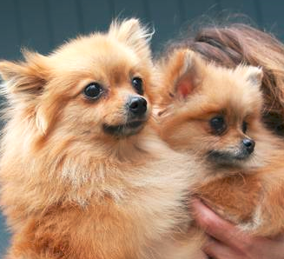
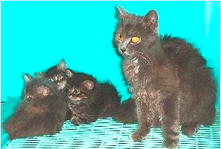
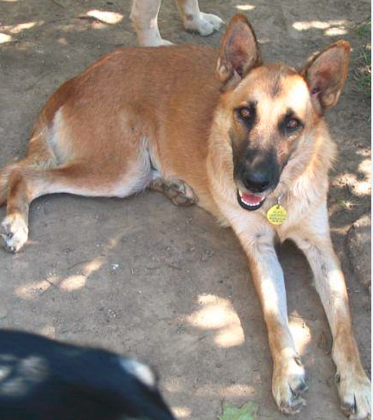
Sample Images

Slide 5
Using OpenCV
Pre-trained Haar Cascade Classifier for cats is used for classifying
haarcascade_frontalcatface_extended.xml and haarcascade_frontalcatface.xml files have been used
scaleFactor = [1.05, 1.1, 1.15, 1.2] and minNeighbors = [5,10,15] were used
Firstly the images were classified as cat and not a cat for all the images of cats using the Cascade Classifier
Secondly the images were classified as dogs and not as dogs for all the images of dogs using Cascase Classifier

Slide 6
What is a Haar Cascade Classifier?
It is a machine learning based approach where a cascade function is trained from a lot of positive and negative images
Extract Haar features from the image
Each Haar feature considers adjacent rectangular regions at a specific location in a detection window, sums up the pixel intensities in each region and calculates the difference between these sums
This difference is then used to categorize subsections of an image

Slide 7
Continued…
In the detection phase of the Viola–Jones object detection framework, a window of the target size is moved over the input image, and for each subsection of the image the Haar-like feature is calculated
Because such a Haar-like feature is only a weak learner or classifier a large number of Haar-like features are necessary to describe an object with sufficient accuracy
The Haar-like features are therefore organized in something called a classifier cascade to form a strong learner or classifier.

Slide 8
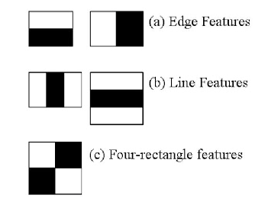
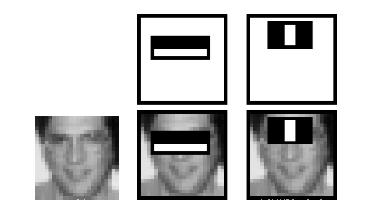
Continued…

Slide 9
Impact of scaleFactor and minNeighbors
scaleFactor is used to create a scale pyramid
Image pyramid is a multi-scale representation of an image, such that the face detection can be scale-invariant, i.e., detecting large and small faces using the same detection window
A larger scale factor will increase the speed of the detector, but could harm our true-positive detection accuracy. Conversely, a smaller scale will slow down the detection process, but increase true-positive detections. However, this smaller scale can increase the false-positive detection rate as well
The minNeighbors parameter controls the minimum number of detected bounding boxes in a given area for the region to be considered an “object”. This parameter is very helpful in pruning false-positive detections

Slide 10
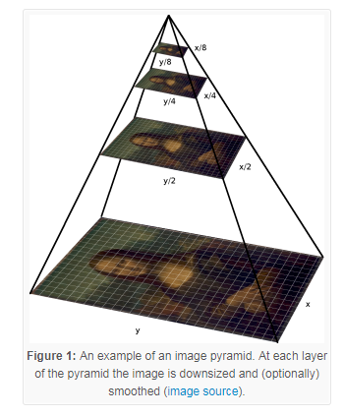
Continued..
Utilizing an image pyramid allows us to find objects in images at different scales of an image. And when combined with a sliding window we can find objects in images in various locations.
The image is progressively subsampled until some stopping criterion is met, which is normally a minimum size has been reached and no further subsampling needs to take place.

Slide 11
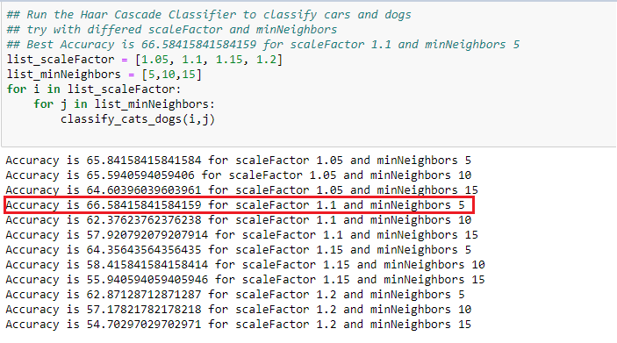
Tuning scaleFactor and minNeighbors

Slide 12
Observations
The biggest problem with Haar cascades is getting the detectMultiScale parameters right, specifically scaleFactor and minNeighbors . We can easily run into situations where we need to tune both of these parameters on an image-by-image basis, which is not ideal
The scaleFactor variable controls the image pyramid which used to detect objects at various scales of an image. If the scaleFactor is too large, then it only evaluate a few layers of the image pyramid, potentially leading to missing objects at scales that fall in between the pyramid layers
On the other hand, if the scaleFactor is set as too low, then it will evaluate many pyramid layers. This will help detect more objects in the image, but it (1) makes the detection process slower and (2) substantially increases the false-positive detection rate, something that Haar cascades are known for

Slide 13
Traditional ML
General machine learning algorithms would not make much sense in case of image data, so we need to extract meaningful features from the image to be able to apply traditional ML algorithms
Below feature extraction techniques from skimage library have been used:
HOG (histogram of oriented gradients)
Spatial binning -- downsize the resolution to retain the most important image characteristic in terms of raw pixel values
Histogram of color intensities – in Red, Blue and Green color scales
Blurring -- focus on only the cat/dog in the picture
Gabor Filtering for edge detection and texture classification

Slide 14
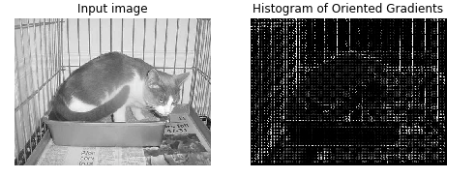
HOG (histogram of oriented gradients)
The distribution ( histograms ) of directions of gradients ( oriented gradients ) are used as features. Gradients ( x and y derivatives ) of an image are useful because the magnitude of gradients is large around edges and corners ( regions of abrupt intensity changes ) and we know that edges and corners pack in a lot more information about object shape than flat regions !!!

Slide 15
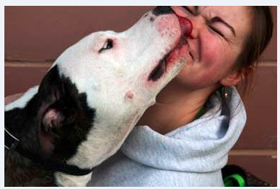
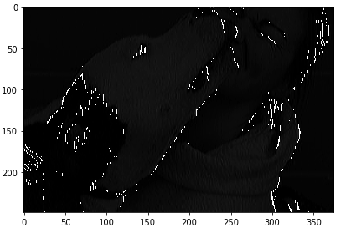
Gabor Filtering
It is a linear filter used for texture analysis which analyzes whether there are any specific frequency content in the image in specific directions in a localized region around the point or region of analysis.
They have been found to be particularly appropriate for texture representation and discrimination.

Slide 16
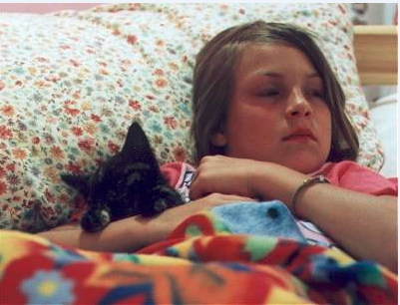
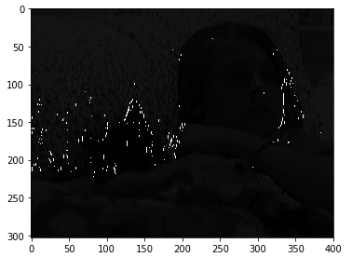
Continued..

Slide 17
Continued…
The features extracted have been combined to create a feature vector
Feature vector is then normalized and used for training
SVM, kNN and Gradient Boosting (gbtree and gblinear) have been used

Slide 18

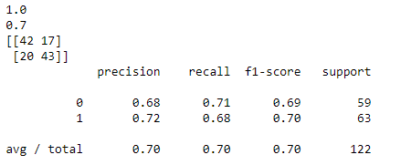
SVM
Test Accuracy: 70%

Slide 19

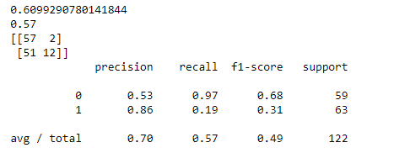
kNN
Test Accuracy: 57%

Slide 20
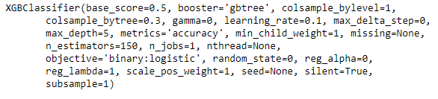
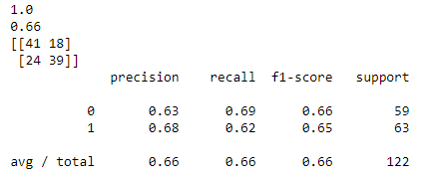
Gradient Boosting(gbtree)
Test Accuracy: 66%

Slide 21
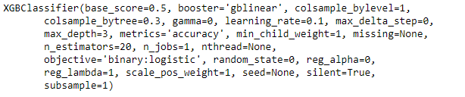
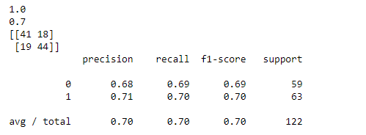
Gradient Boosting(gblinear)
Test Accuracy: 70%

Slide 22
Observations
Better than the Haar Cascade classifier
Uses some specific filters and histograms to extract features
Overfitting seems to be an issue
More filters could have been explored: http://scikit-image.org/docs/dev/api/skimage.filters.html#skimage.filters.gabor

Slide 23
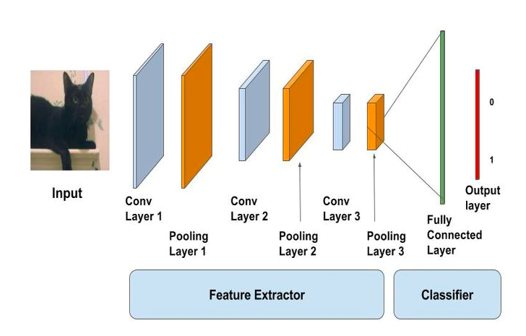
CNN
Feed forward artificial neural networks, extremely effective for image and video processing
Local connectivity
Space/translation invariant
Shared weights architecture

Slide 24
CNN Models
CNN architecture from scratch
Transfer learning using VGG16
Transfer learning using NASNet (NASNetMobile used)
Data Augmentation with transfer learning using ResNet50

Slide 25
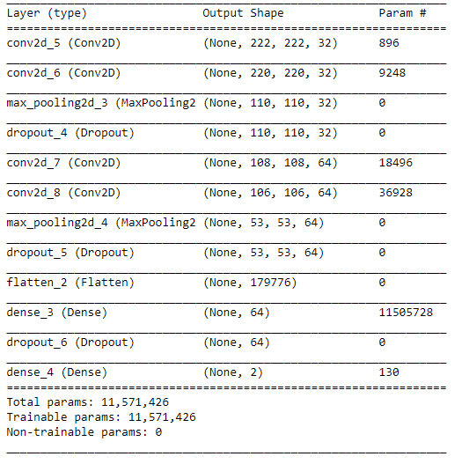
CNN
Test Accuracy: 50%

Slide 26
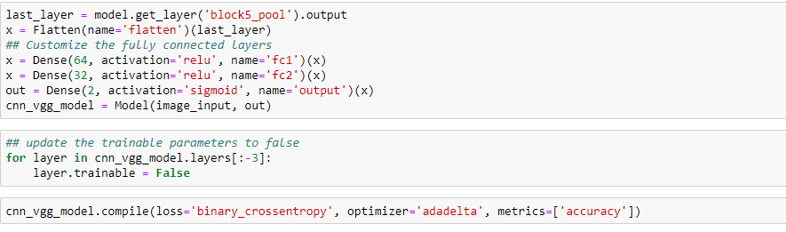
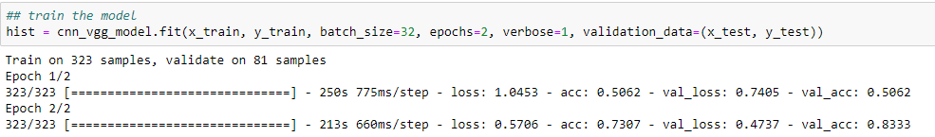
VGG16
The fully connected layers are customized as below:
Test Accuracy: 83%

Slide 27
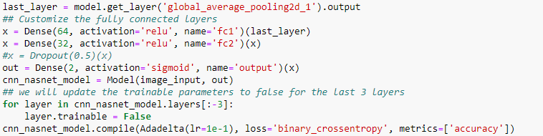
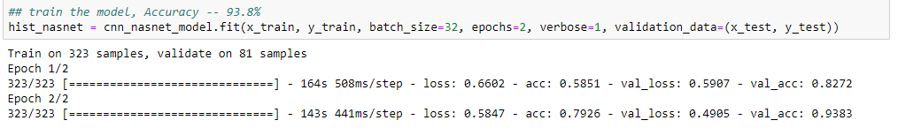
NASNetMobile
The fully connected layers are customized as below:
Test Accuracy: 93.8%

Slide 28
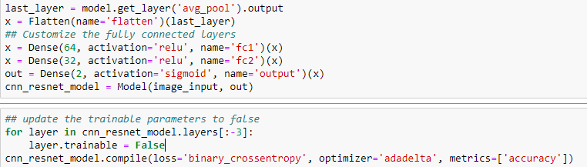
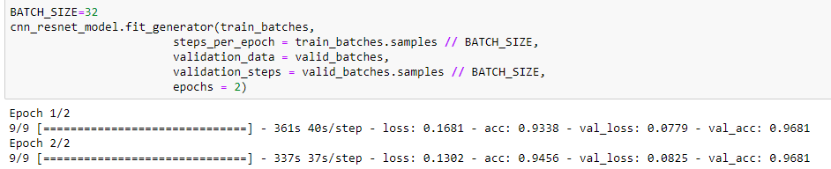
Data Augmentation with ResNet50
Data Augmentation methods like rotating, width shifting, height shifting, zoom, channel shift (adding noise), horizontal flipping(mirror) have been used. The fully connected layers have been customized:
Test Accuracy: 96.8%

Slide 29
Observations
Data augmentation improved the accuracy
CNNs seems to give a good accuracy for most cases

Slide 30
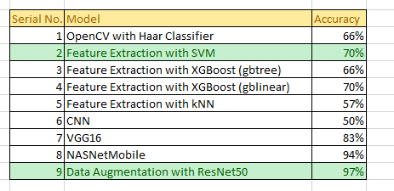
Model Summary

Slide 31
At a Glance
OpenCV (Haar Feature Classifier)
Convolutional Neural Network
Haar Feature is like a kernel in CNN, but the Haar features are manually determined, so need to train them
Good in detecting edges and lines, hence effective for face detection
There is a certain limit to type of things it can detect. If we manipulate the images a bit (say cover one eye), it might not be able to detect the face
Requires relatively smaller data set
Less computations, hence faster
A kernel in CNN, is not pre-determined, and is learned while training
Even if we manipulate the images a bit, CNN is very effective in determining them as CNN kernel has a higher degree of freedom
Given a training data set, which is fairly large, it can detect/classify any object
Learns the hierarchy of features and hence we can do transfer learning
Requires relatively larger data set
More computations, hence slower

Slide 32
Conclusion
Deep Learning models (especially pre-trained CNNs) by far give the best accuracy for image classification task
Clearly CNNs are an appriopriat choice for such scenarios
Data augmentation should be used to increase training samples, avoid overfitting and generalize better
OpenCV and Traditional MLs can achieve a moderate accuracy of 65-70% in most cases

Slide 33
What else can be done?
Use SIFT/SURF for extracting scale invariant features
Use more data augmentation techniques with Traditional ML approaches
Convert the images into HDR (high dynamic range) and then perform feature extraction using some combination of filters – working on currently
Training more layers of pre-trained DNN architectures to suite our use case
Explore more DNN architectures – YOLO, SqueezeNet, GAN (Generative Adversarial Network), RCNN (Region Based CNN), Fast RCNN, Single-Shot Detector (SSD)

Slide 34
Thank You

